Slide 1

Exam AZ-300/303: Microsoft Azure Architect Technologies Crash Course
Tim Warner

Slide 2


Tim Warner
Based in Nashville, TN, US
MCT, MVP
Twitter: @TechTrainerTim
Badge: timw.info/azarchcert

Slide 3
Course Materials
timw.info/az300

Slide 4
Session 1 of 2 Learning Goals
Introduction
Implement and Monitor Azure infrastructure
Storage
Compute
Identity
Monitoring

Slide 5
Session 2 of 2 Learning Goals
Workload Migration
Azure Migrate
Network Load Balancing and Security
Governance
Application Infrastructure
Data Platform
AZ-300/303 exam strategy

Slide 6
Setting Expectations
Azure Architect is an expert-level certification
You should already know how to deploy and configure Azure resources
This is a "crash course"
Please plan to review these materials more than once
Five-minute break at midpoint
Please ask/answer questions and provide feedback in the Q/A panel, not the group chat

Slide 7
2020 Exam Update Information
Microsoft Worldwide Learning (WWL) revisits the Azure role-based certs yearly
Relevant blog post: timw.info/az2020
Changes:
AZ-300 replaced with AZ-303
AZ-301 replaced with AZ-304
AZ-303 beta is available now
AZ-300 retires around September 30, 2020

Slide 8
2020 Exam Update Information
You can earn your badge by combining the old and new exam versions:
AZ-300 and AZ-304
AZ-301 and AZ-303
The certification is the same, and has a 2-year expiry

Slide 9
Tim's Certification Study Pyramid
Interdependence
Content knowledge
Practical application
Test-taking skills

Slide 10
Module 1: Deploy and Configure Azure Infrastructure

Slide 11
Storage Account Replication
1
3
3
2
LRS
ZRS

Slide 12
Storage Account Replication
1
3
1
3
2
2
GRS – RA/GRS

Slide 13
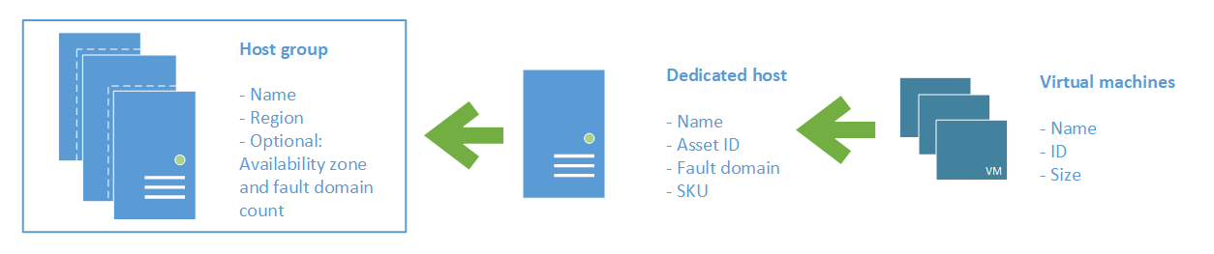
Azure VM Dedicated Host

Slide 14
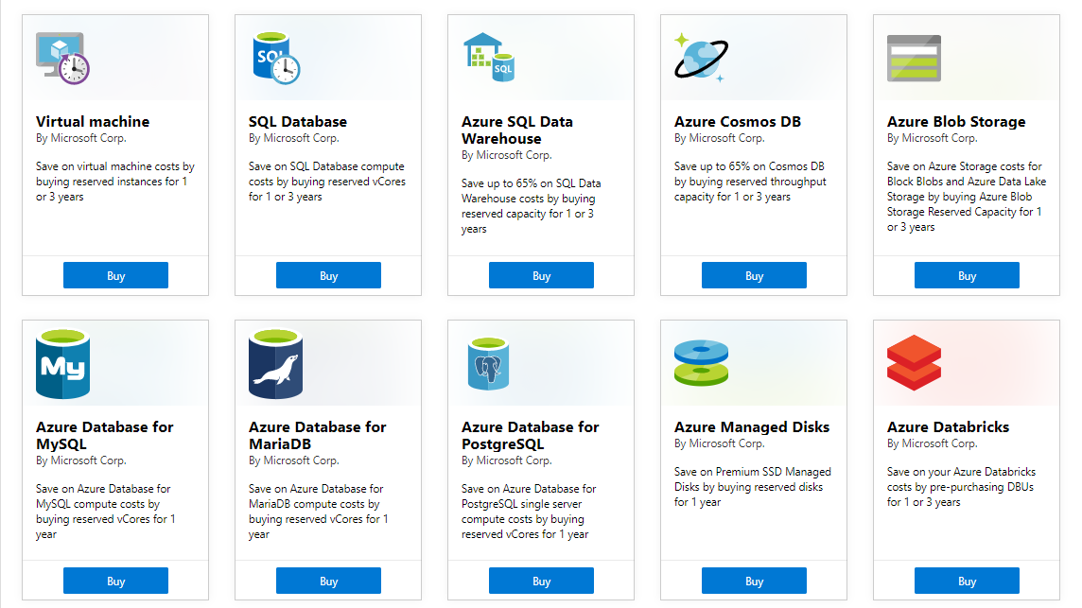
Azure Reservations

Slide 15

Availability Set

Slide 16

Availability Zone

Slide 17

Hybrid Networking

Slide 18

VNet Peering

Slide 19

Network Virtual Appliance

Slide 20

Load Balancing

Slide 21

Azure Load Balancer

Slide 22

Application Gateway

Slide 23

Traffic Manager

Slide 24

Front Door Service

Slide 25

Tenant vs. Subscription

Slide 26

Hybrid Identity

Slide 27

Federated Identity

Slide 28
Module 2 Implement Azure Workloads and Security

Slide 29
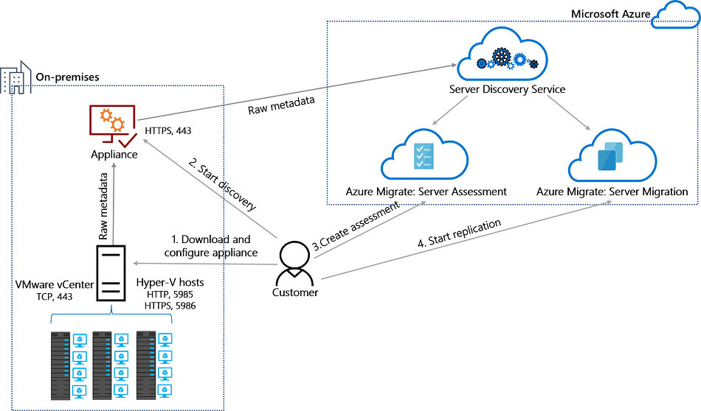
Azure Migrate

Slide 30
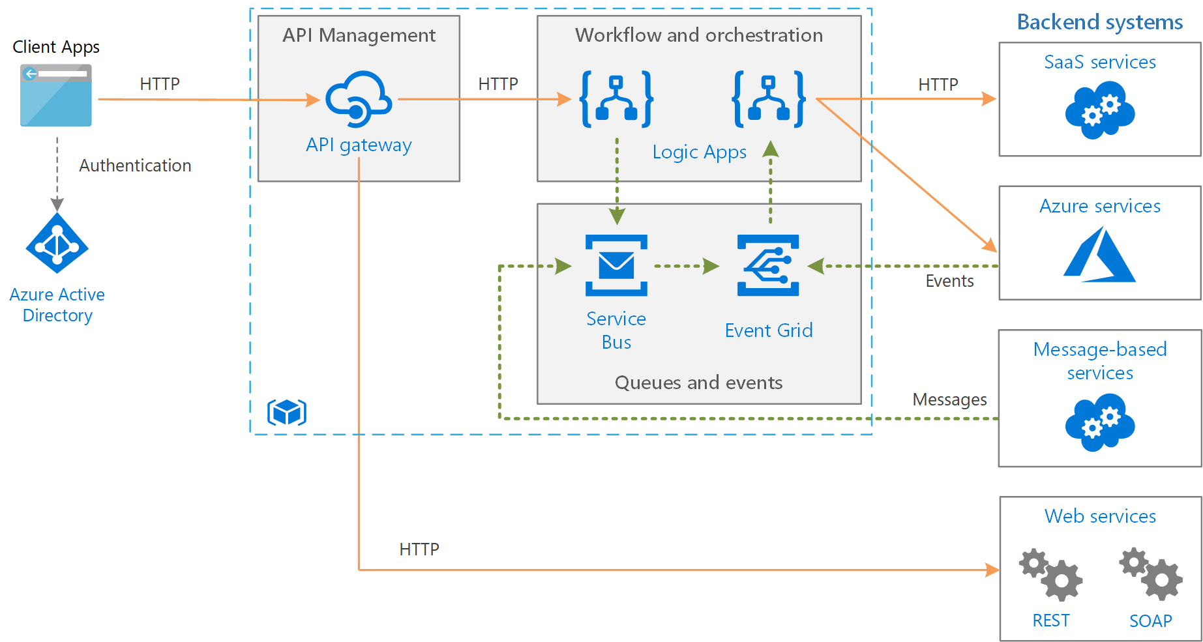
Message-Based Architecture

Slide 31

Azure Management Scopes
/ Tenant Root

Slide 32

Monitoring

Slide 33
Module 3: Create and Deploy Apps in Azure

Slide 34


Docker Container Lifecycle
https://timw.info/3635f

Slide 35
Module 4: Implement Authentication and Secure Data in Azure

Slide 36
Hybrid Identity

Slide 37
Federated Identity

Slide 38

Passthrough Authentication

Slide 39

Seamless Single Sign-on

Slide 40
Module 5: Develop for the Cloud and for Azure Storage

Slide 41

VM Scale Sets

Slide 42
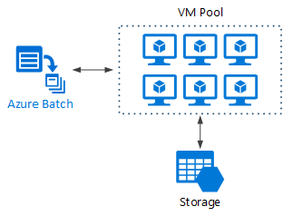
Azure Batch

Slide 43
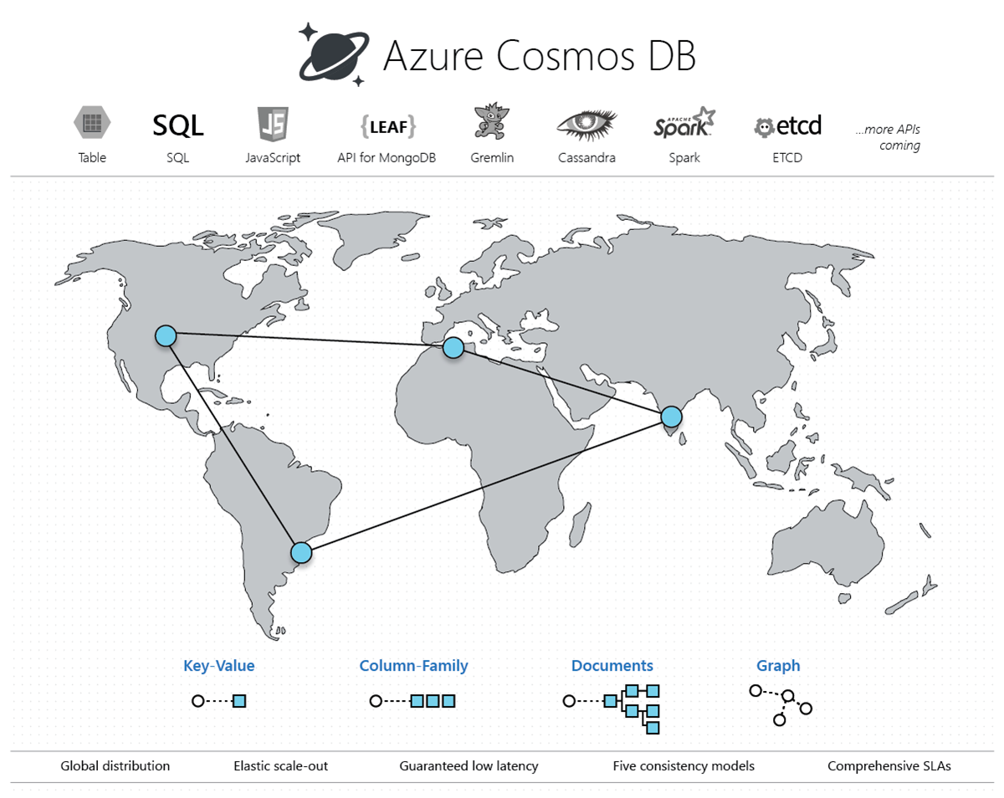
Cosmos DB

Slide 44

Always Encrypted

Slide 45
Module 6: Exam AZ-300 Exam Strategy

Slide 46
Module 6 Learning Objectives
Grasp the content
Acquire the hands-on skills
Master computer-based testing
Comprehend what to expect before, during, and after the exam

Slide 47
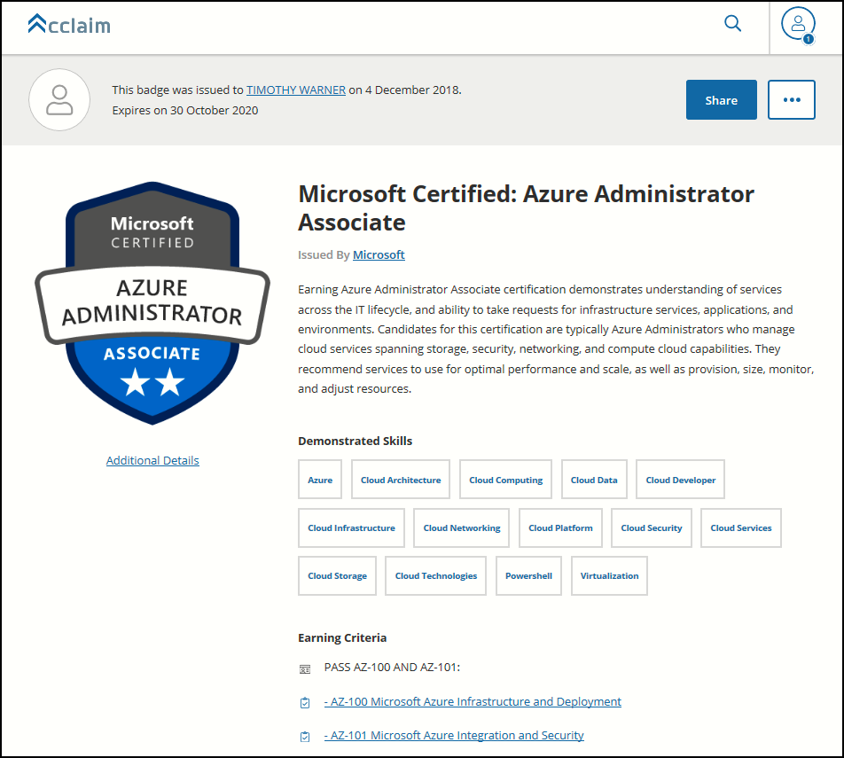
Digital Credentials by Credly/Acclaim

Slide 48
Exam AZ-300/303 Item Types

Slide 49

Multiple Choice

Slide 50
Repeated Scenario
You need to move an Azure VM to another hardware host.
Solution: You redeploy the VM.
Does this solution meet the goal?
Yes
No

Slide 51

Select and Place

Slide 52

Build List and Reorder

Slide 53

Active Screen/Fill in the Blank

Slide 54

Case Study

Slide 55






Performance-Based Lab

Slide 56
Microsoft Online Testing

Slide 57

Microsoft Online Testing Process

Slide 58

Microsoft Online Testing Process

Slide 59

Microsoft Online Testing Process

Slide 60

Microsoft Online Testing Process

Slide 61

Microsoft Online Testing Process

Slide 62

Microsoft Online Testing Process

Slide 63

Microsoft Online Testing Process

Slide 64
AZ-300 Exam Strategy/Tips
Focus your skills accordingly:
60 percent Azure portal
20 percent Azure PowerShell
10 percent Azure CLI
10 percent KQL
Expect performance-based labs, but be thankful if you don't see 'em

Slide 65
Thank you!
Course materials: timw.info/az300
Twitter: @TechTrainerTim
Work: timw.info/ps
Web: TechTrainerTim.com

Slide 66
Exam AZ-300/303: Microsoft Azure Architect Technologies Crash Course
Tim Warner

Slide 67
Tim Warner
Based in Nashville, TN, US
MCT, MVP
Twitter: @TechTrainerTim
Badge: timw.info/azarchcert

Slide 68
Session 2 of 2 Learning Goals
Sweep up the shavings from yesterday
SSPR & MFA
Azure Migrate & VM Backup
Network Load Balancing and Security
Governance
Application Infrastructure
Data Platform

Slide 69
Course Materials
timw.info/az300

Slide 70
Azure Migrate

Slide 71
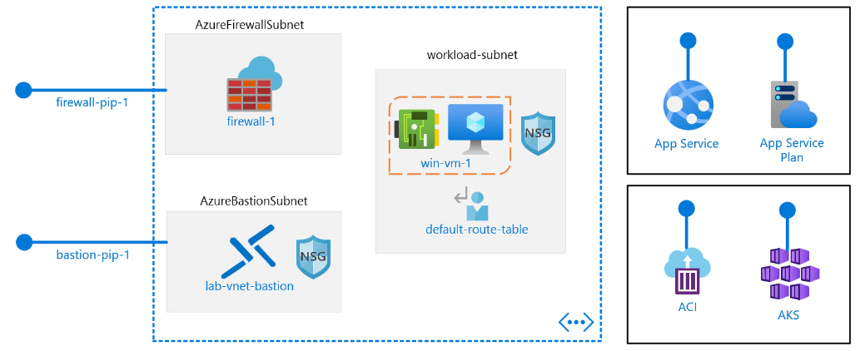
Core Networking

Slide 72
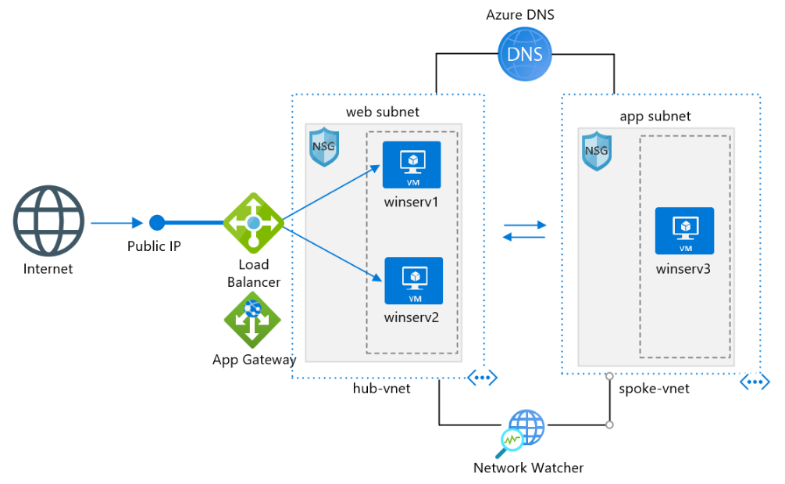
Core Networking

Slide 73
VNet Peering

Slide 74
Load Balancing

Slide 75
Azure Load Balancer

Slide 76
Hybrid Networking

Slide 77
Network Virtual Appliance

Slide 78
Application Gateway

Slide 79
Traffic Manager

Slide 80
Front Door Service

Slide 81
Azure Management Scopes
/ Tenant Root

Slide 82
Docker Container Lifecycle
https://timw.info/3635f

Slide 83

Event Architecture

Slide 84
Cosmos DB

Slide 85
Always Encrypted

Slide 86
Module 6: Exam AZ-300 Exam Strategy

Slide 87
Module 6 Learning Objectives
Grasp the content
Acquire the hands-on skills
Master computer-based testing
Comprehend what to expect before, during, and after the exam

Slide 88
Digital Credentials by Credly/Acclaim

Slide 89
Microsoft Online Testing

Slide 90
Microsoft Online Testing Process
timw.info/online

Slide 91
AZ-300 Exam Strategy/Tips
Focus your skills accordingly:
60 percent Azure portal
20 percent Azure PowerShell
10 percent Azure CLI
10 percent KQL
Expect performance-based labs, but be thankful if you don't see 'em

Slide 92
Thank you!
Course materials: timw.info/az300
Twitter: @TechTrainerTim
Work: timw.info/ps
Web: TechTrainerTim.com

